Slide 1
Tutorial 1: First OpenGL Program
TA: Chenqi Luo, Yuehao Wang

Slide 2
Agenda
Learning Materials
About homework
GUI Window & Load OpenGL
OpenGL coding

Slide 3
Learning Materials
Web
https://learnopengl-cn.github.io
https:// www.opengl-tutorial.org
https://www.khronos.org/opengl/wiki/Tutorials
Book
OpenGL Programming Guide: The Official Guide to Learning OpenGL,
Real-Time Rendering, 3rd Edition

Slide 4
About Homework
Create your assignment repo via Git Classroom : https://classroom.github.com/a/6v8E5SYL
Clone your own private repository to the local through git.
Coding folder already includes the skeleton code and the objects you should render.
You are required to write a report in LaTex using provided template, then put it in Report folder.

Slide 5
Grading Rules
You can choose to do the [optional] item, and if you choose to do it, you will get additional scores based on the additional work you have done. But the maximum additional score will not exceed 20% of the entire score of this assignment.
NO CHEATING! If found once, your score for this assignment is zero. If found twice, the total score deducted 2 times of the assignment. If found third times, your will fail the course.
You are required to work INDEPENDENTLY. We fully understand that implementations could be similar somewhere, but they cannot be identical. To avoid being evaluated inappropriately, please show your understanding of code to TAs.
Late submission of your assignment will subject to score deduction.

Slide 6
Assignment Requirement
Programming Requirements
[must] You are required to enable the multi-sample full-screen antialiasing functionality of OpenGL. (5%)
[must] You are required to load mesh objects from files and draw the meshes. (45%)
[must] You are required to render objects with Phong lighting model. (20%)
[must] You are required to manipulate the camera and use keyboard to control the camera: you can use keyboard to translate and rotate the camera so that you can walk in the virtual scene. (30%)
[optional] You can build a shader program to support Phong shading or you can support lighting with multiple point light sources, etc. (20%)
Submission
project scripts and an executable program in Coding folder.
a PDF-formatted report which describes what you have hone in Report folder.
Submission deadline: 22:00, March 17, 2021

Slide 7
Live Demo

Slide 8
GUI Window & Load OpenGL
窗口管理
古老产品：glut/freeglut
替代品：glfw
函数加载
古老产品：glew
替代品：glad
通常有这三种环境配置
(1) glfw+glew
(2) glfw+glad (推荐)
(3) freeglut

Slide 9
OpenGL Pipeline
从OpenGL几何图元中设置数据，用于构建形状。
使用不同的着色器 (shader)，对输入的图元数据执行计算操作，判断它们的位置、颜色以及其他渲染属性。
光栅化 (rasterization): 将输入图元的数学描述转换为与屏幕位置对应的像素片元 (fragment)。
针对光栅化过程产生的每个片元，执行片元着色器 (fragment shader)，从而决定这个片元最终的颜色。

Slide 10
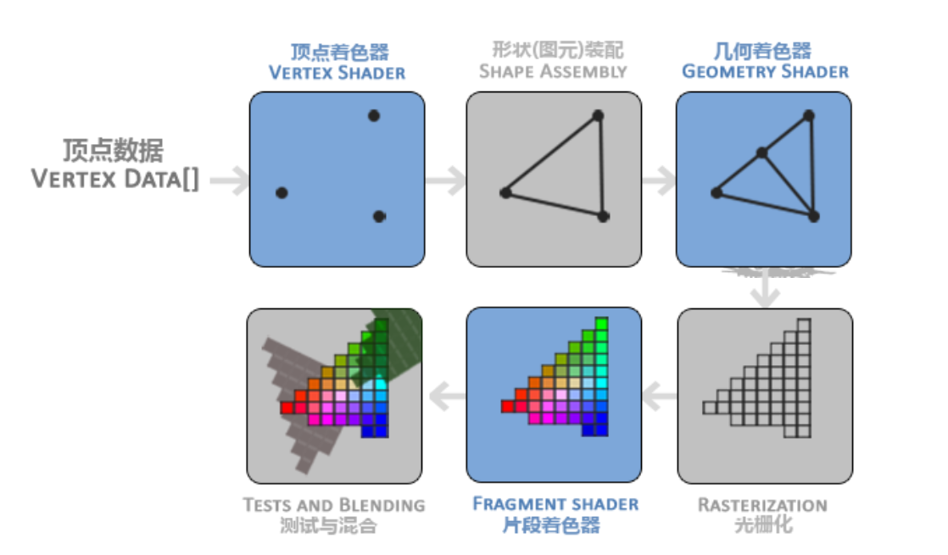
OpenGL Rendering Pipeline (渲染管线)

Slide 11
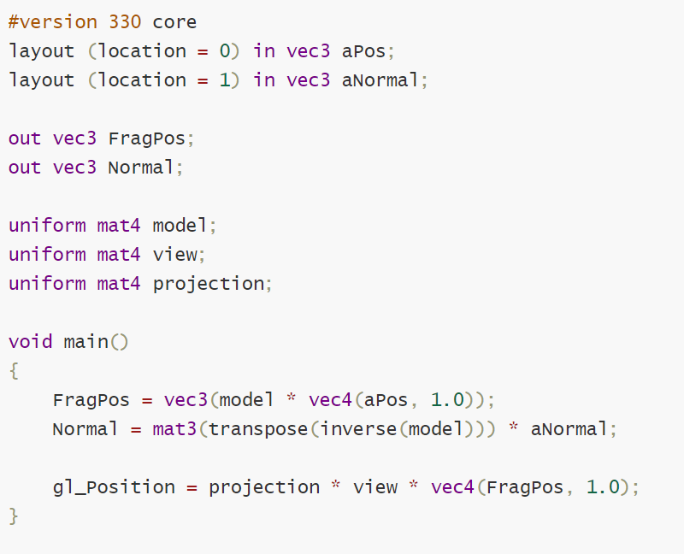
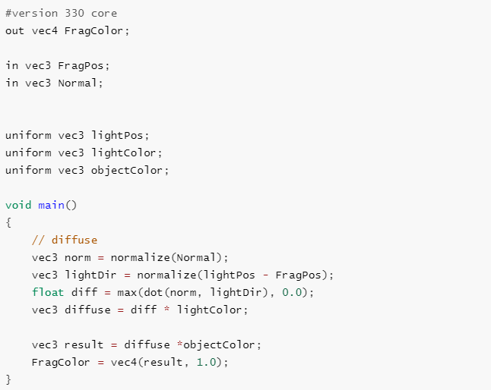
Shader language——GLSL
gl_Position是顶点着色器裁切空间输出的位置向量

Slide 12
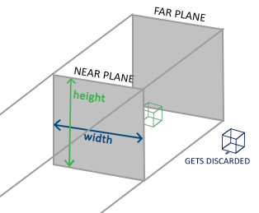
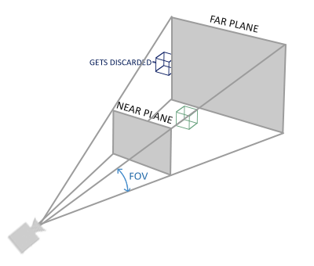
Two Projection
正射投影 (Orthographic Projection Matrix)
参数：宽、高、近平面 (Near) 和远平面(Far)
透视投影 (Perspective Projection Matrix)
参数：Fov, 宽、高、近平面(Near)和远平面(Far)

Slide 13
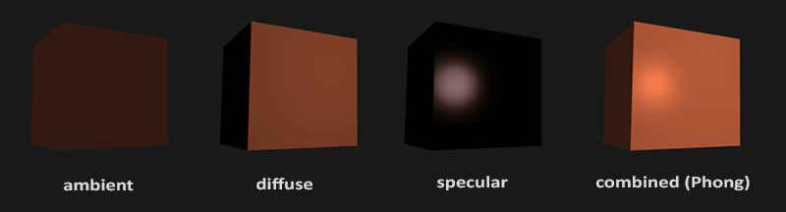
Phong Lighting Model
Ambient 环境光
Diffuse 漫反射光
Specular 镜面
Reference: https://learnopengl.com/Lighting/Basic-Lighting

Slide 14

Coordinate system
Local space 局部空间
World space 世界空间
Camera space 观察空间
Clip space 裁切空间

Slide 15
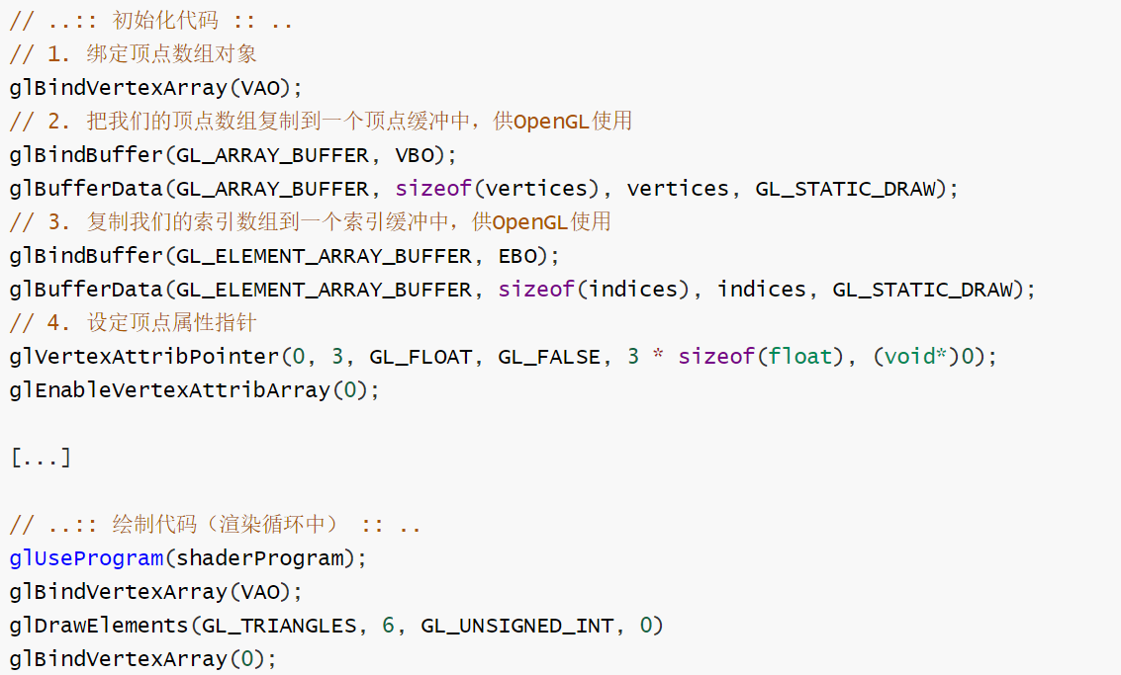
VAO,VBO,EBO
VAO: 顶点数组对象
VBO: 顶点缓冲对象
EBO: 索引缓冲对象

Slide 16
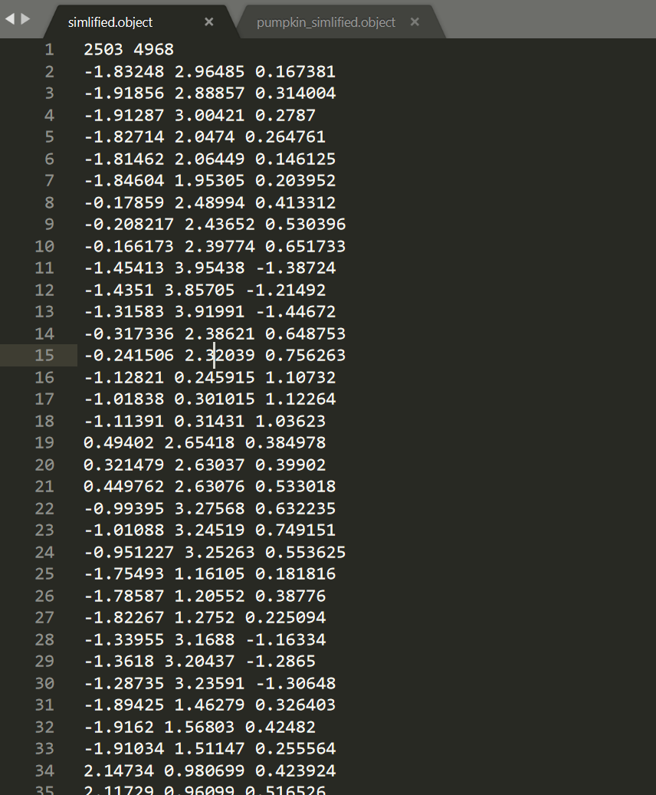
Load Mesh Object From A File
2503 顶点个数
4968 面个数
(2503行)顶点坐标
(2503行)顶点法线
(4968行)面索引

Slide 17
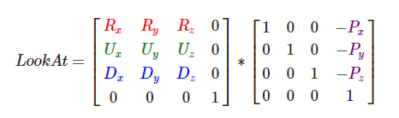
Camera
Z轴指向屏幕
方向向量(direction)
向上向量(up)
向右向量(right)x轴正方向

Slide 18
Walk around
前后移动
cameraPos +=(-=) cameraSpeed * cameraFront;
左右移动
把up向量与front 向量叉乘，得到right向量
cameraPos -= glm::normalize(glm::cross(cameraFront, cameraUp)) * cameraSpeed;
鼠标控制
通过鼠标的位置的改变计算出yaw pitch的改变，最后更新到 camera的front向量

Slide 19
Depth Test
glEnable(GL_DEPTH_TEST);
如果你开启了深度测试，那么你需要在每次渲染迭代前先clear深度缓存:
glClear(GL_COLOR_BUFFER_BIT | GL_DEPTH_BUFFER_BIT);

Slide 20
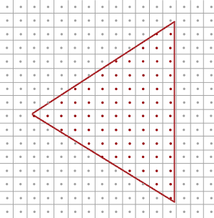
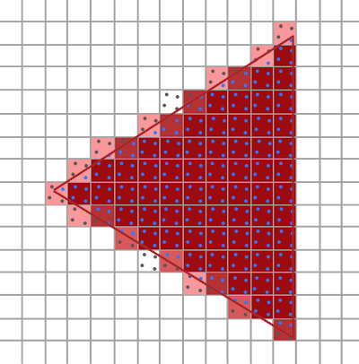

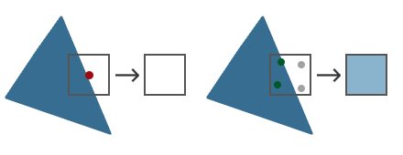
Anti-aliasing
Super Sample (SSAA)
MultiSampling (MSAA)
In OpenGL:

Slide 21
References
M, Jakob W, Humphreys G. Physically based rendering: From theory to implementation[M]. Morgan Kaufmann, 2016.
Learn OpenGL: https://learnopengl.com/
Life of a triangle - NVIDIA's logical pipeline: https://developer.nvidia.com/content/life-triangle-nvidias-logical-pipeline

